Slide 1

Syntax and Semantics
Syntax: the form or structure of the expressions, statements, and program units.
Semantics: the meaning of the expressions, statements, and program units.
Syntax and semantics provide a language’s definition
Users of a language definition
Other language designers
Implementers
Programmers (the users of the language)
CIS 331

Slide 2
Grammars
Grammar: a finite non-empty set of rules.
An Example Grammar
<program> → <stmts>
<stmts> → <stmt> | <stmt> ; <stmts>
<stmt> → <var> = <expr>
<var> → a | b | c | d
<expr> → <term> + <term> | <term> - <term>
<term> → <var> | const
CIS 331

Slide 3
Semantics
There is no single widely acceptable notation or formalism for describing semantics.
Operational Semantics
Describe the meaning of a program by executing its statements on a machine, either simulated or actual. The change in the state of the machine (memory, registers, etc.) defines the meaning of the statement.
Evaluation of operational semantics:
Good if used informally (language manuals, etc.)
Extremely complex if used formally
CIS 331

Slide 4
Semantics
Axiomatic Semantics
Based on formal logic (predicate calculus).
Original purpose: formal program verification
Developing axioms or inference rules for all of the statements in a language is difficult.
Its usefulness in describing the meaning of a programming language is limited for language users or compiler writers.
Denotational Semantics
Based on recursive function theory.
The most abstract semantics description method.
Can be used to prove the correctness of programs.
Because of its complexity, it are of little use to language users.
CIS 331

Slide 5
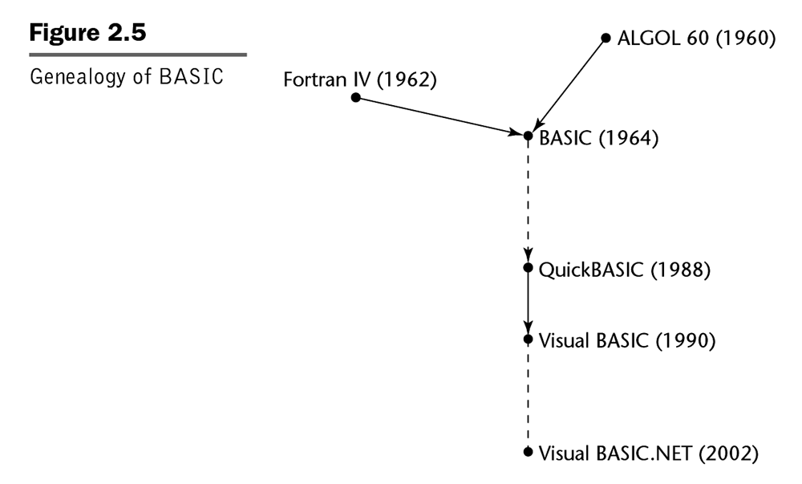
The “BASIC Branch”
CIS 331

Slide 6
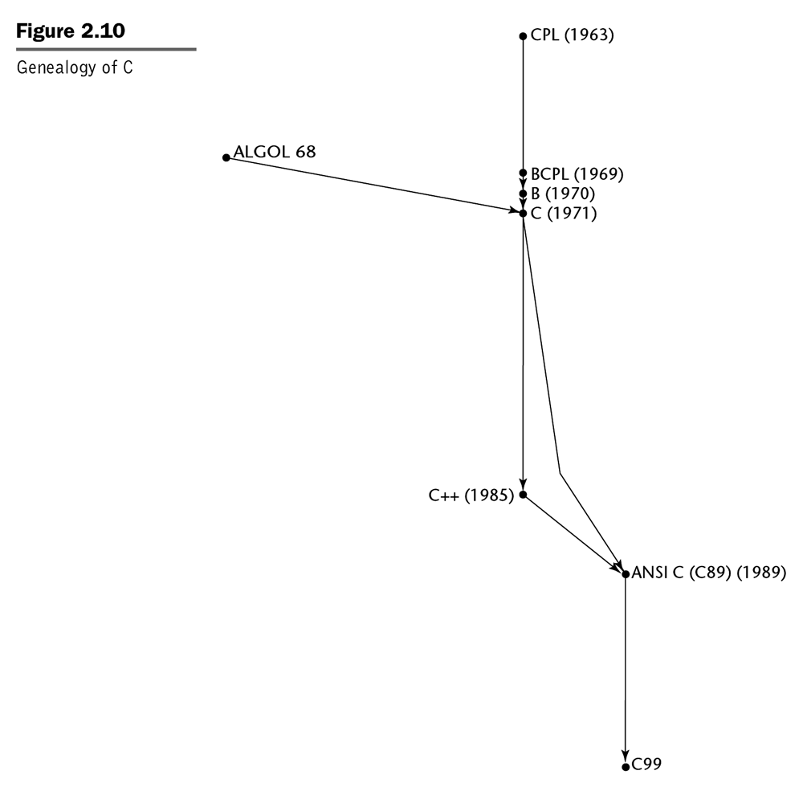
The “C++ Branch”
CIS 331

Slide 7
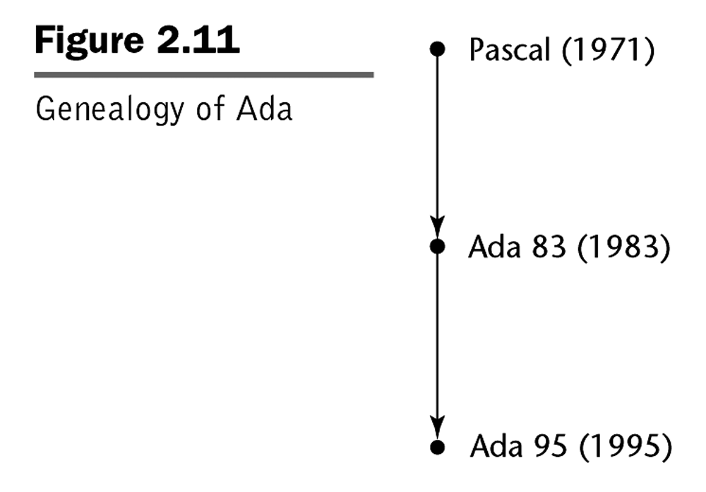
The “Ada Branch”
CIS 331

Slide 8
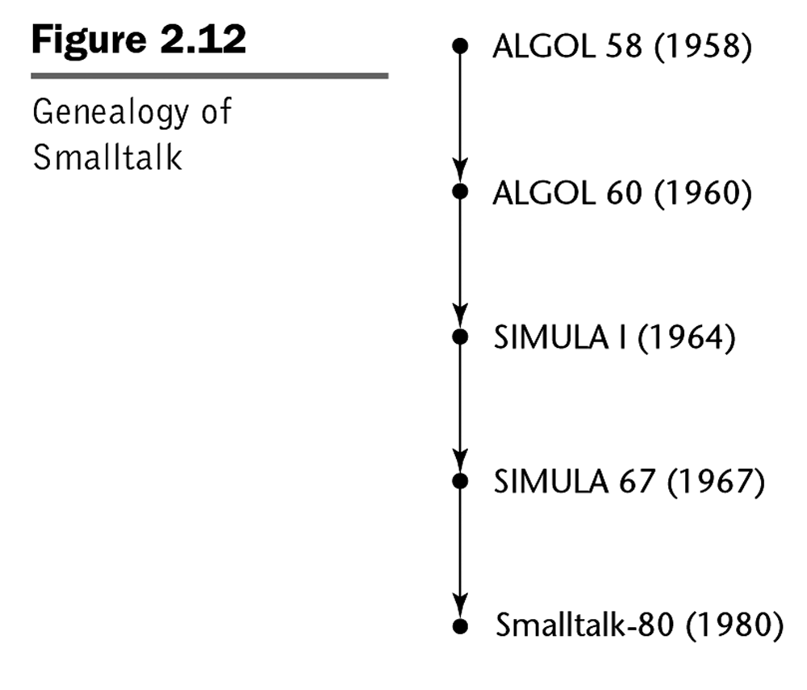
The “Smalltalk Branch”
CIS 331

Slide 9
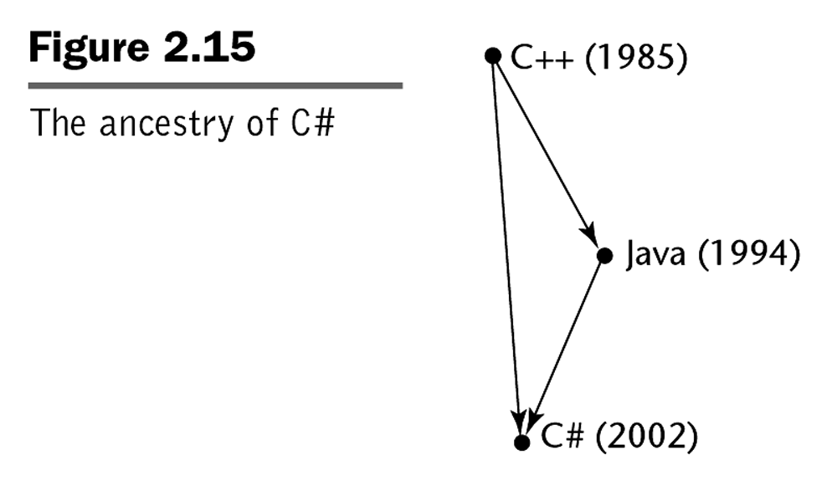
The “Java Branch”
CIS 331

Slide 10
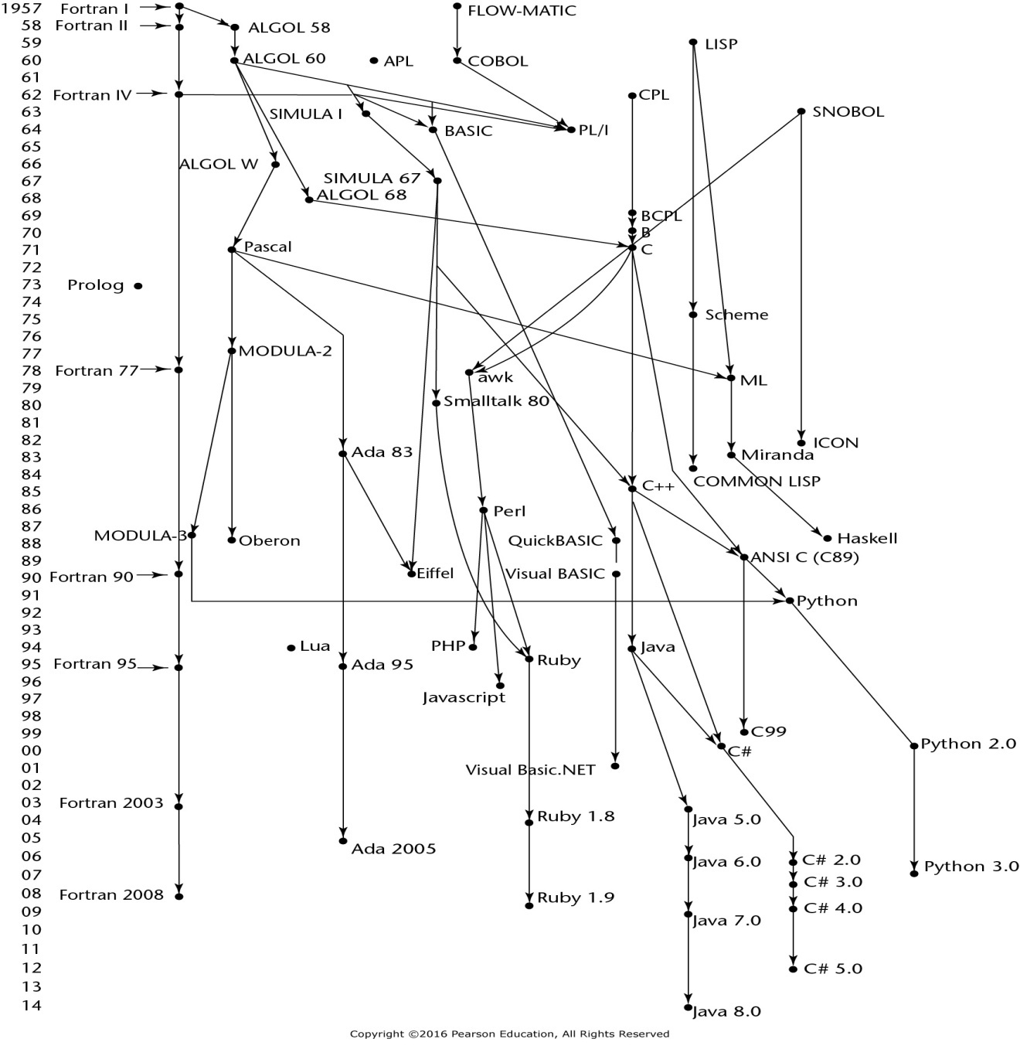
A Brief History of Programming Languages
CIS 331

Slide 11
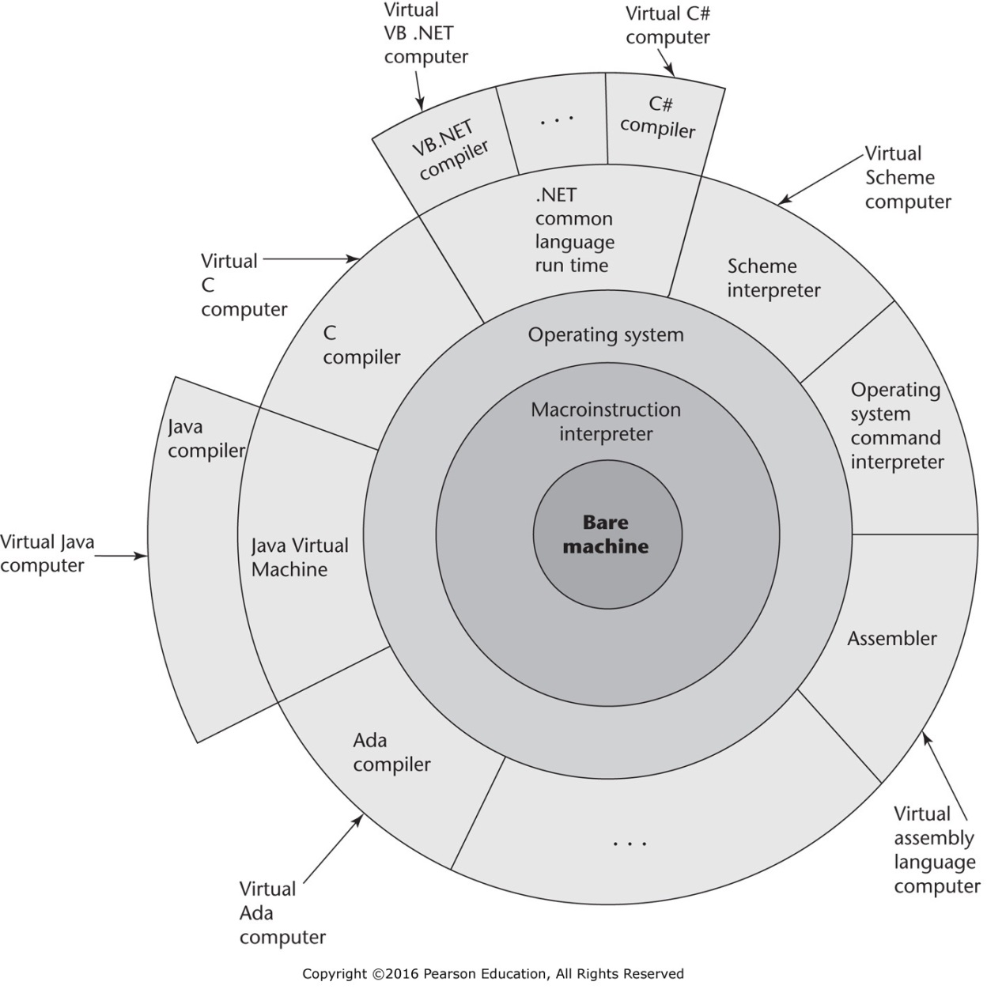
Layered interface of virtual computers provided by a typical computer system
CIS 331

Slide 12
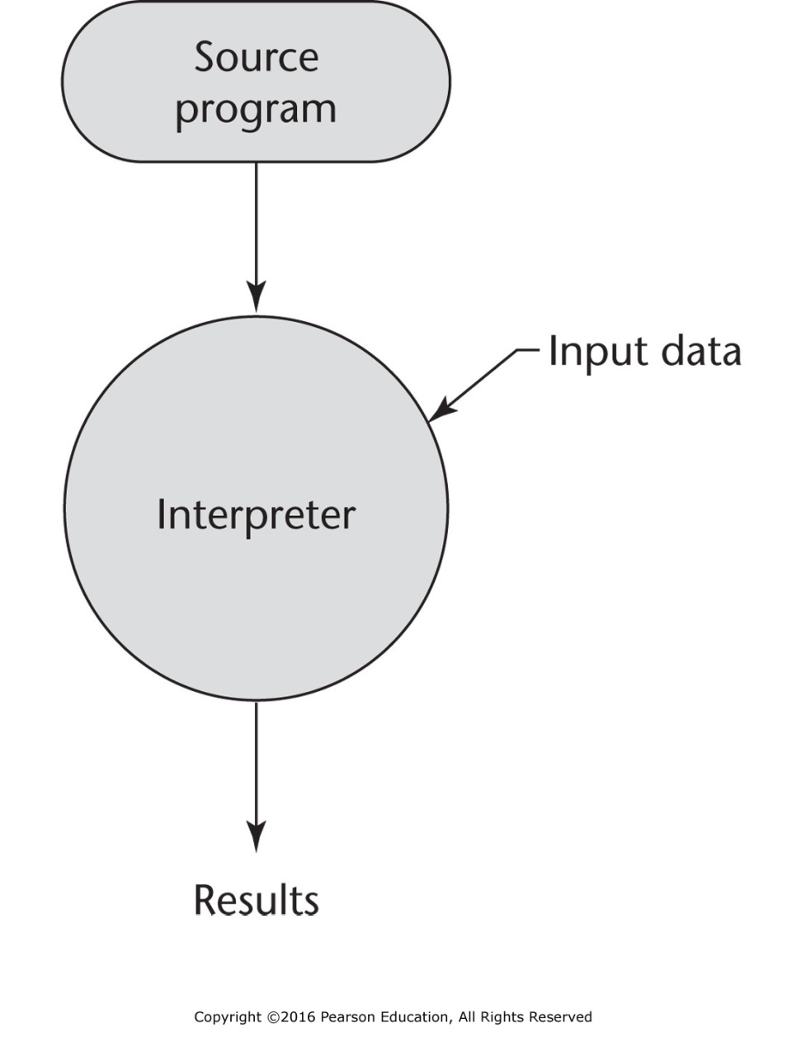
Pure interpretation
CIS 331

Slide 13
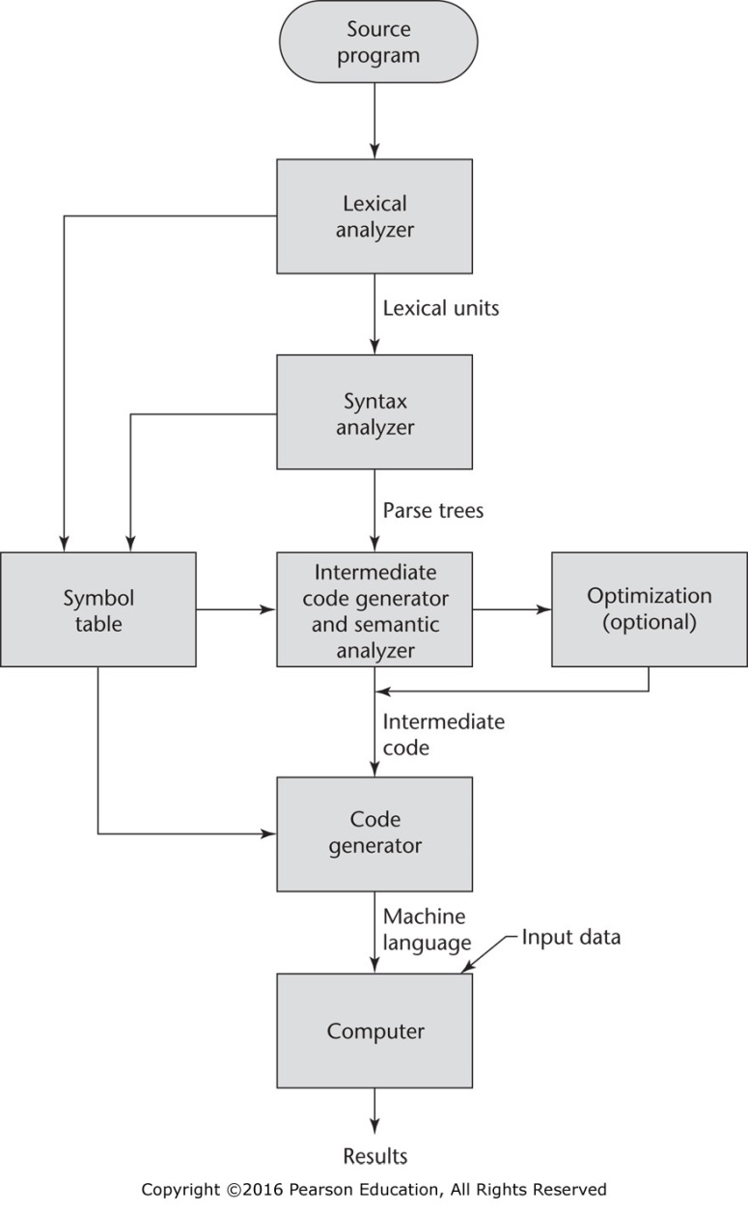
The compilation process
CIS 331

Slide 14
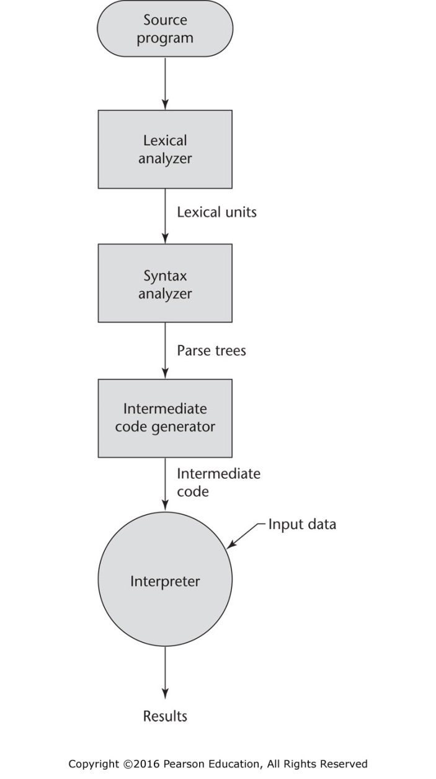
Hybrid implementation system
CIS 331

Slide 15
Reference
“Concepts of Programming Languages (11th Edition)” by Robert W. Sebesta.
Addison Wesley 2015. ISBN: 978-0133943023.
CIS 331

