Slide 1
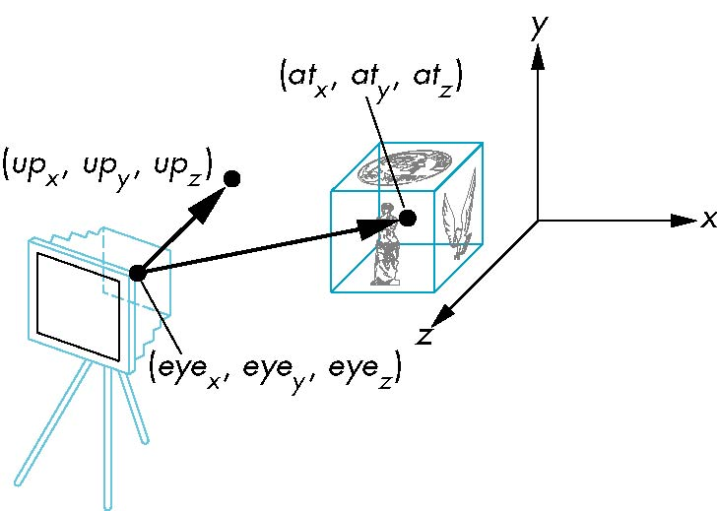

gluLookAt function
CIS 405

Slide 2
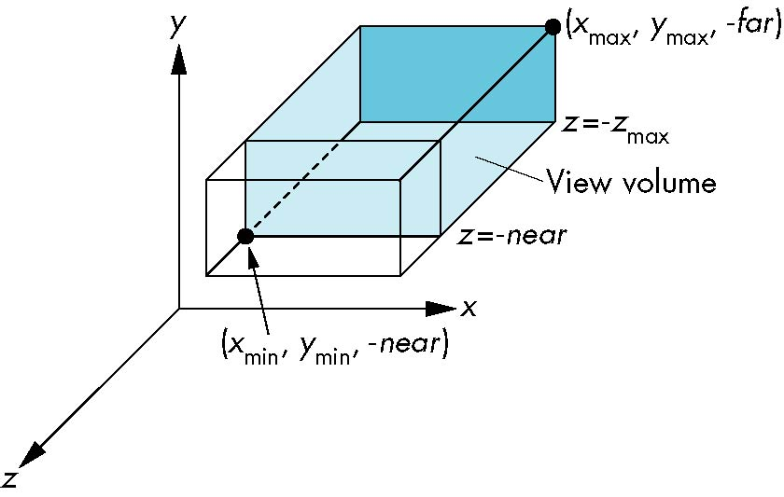
Orthographic Projection
CIS 405

Slide 3
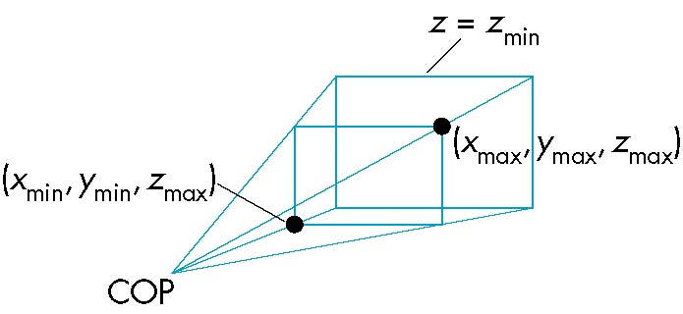
Perspective Projection
CIS 405

