Slide 1

Basic SDLC Models
SDLC → System Development Life Cycle.
Why models? Due to the complexity of software systems.
Model examples
  Waterfall model
  Spiral model
  RUP (Rational Unified Process) model
  Agile models
CIS 487

Slide 2
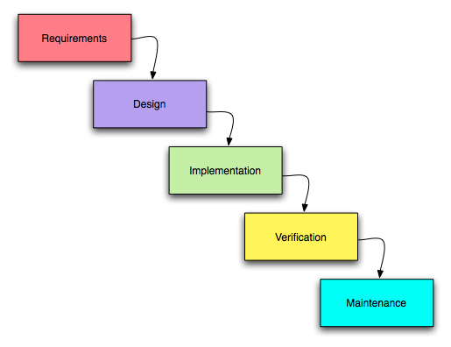
Waterfall Model
CIS 487

Slide 3
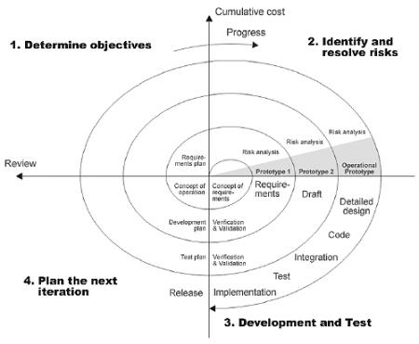
Spiral Model
CIS 487

Slide 4
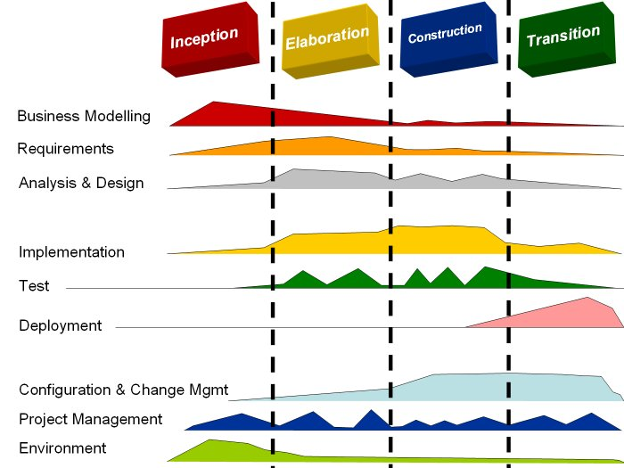
RUP Model
CIS 487

Slide 5
Agile Models
Important example - Extreme Programming (XP).
Currently the best-known and most widely used agile method.
XP takes an “extreme” approach to iterative development.
New versions may be built several times per day.
Increments are delivered to customers every 1 - 2 weeks.
All tests must be run for every build and the build is only accepted if tests run successfully.
CIS 487

Slide 6
“Simplified RUP”
Business analysis
Requirements
Analysis. Logical design – process and data.
Design. Interaction, data, and architecture.
Implementation and testing.
Deployment and maintenance.
Use appropriate tools such as UML diagrams.
CIS 487

Slide 7
Reference
Wiki - Wikipedia, the free encyclopedia.
“Software Engineering (8th Edition)” by Ian Sommerville. Addison Wesley 2006. ISBN-10: 0321313798. ISBN-13: 978-0321313799.
CIS 487

